Slide 1
Understanding,
Communicating, and Monitoring the Budget
Sonoma Charter School Board Workshop
January 23, 2023

Slide 2
What we’ll cover today
Budget Overview
  Budget development and school priorities
  Aligning resources ($$) to impact student achievement
  How the board knows what’s going on in the budget: monitoring the budget
  Timeline for budget development
Current Budget Review
Budget Reduction process
  Define Budget priorities
    Working with board, staff, and community regarding school priorities
  Look for “low-hanging fruit” as far from classroom as possible
  Develop “skeleton” budget, build from there
Staff Salaries
  Maintaining staff

Slide 3
Budget OVERVIEW: DEVELOPMENT and District Goals and Objectives
Align the two processes.
  First set the school priorities
  Use them to drive the budget.
  Involve the community, especially if budget reductions are looming.
Be sure student achievement is the over-arching priority (it’s our job!)
  Then tie all other priorities into it
  For instance, retaining staff is critical to student achievement, so it becomes a top priority

Slide 4
Involving our community
Presentation to Board and Community in 2004 as we prepared for more budget reductions: Board/Comm04

Slide 6
Regular Monitoring - Superintendent
Each month, if not more often, reviews the budget
  Looks at it by categories (resource and object). Anything stick out?
  Looks at percentage of budget spent to date - too much? Too little? What’s going on?
  Checks interim reports against budget, checks expenditures - anything seem off?
  Looks at cash flow projections. Do you need a TRANS (short term loan offered to schools?)?
  Adjust spending as necessary. Implement freeze?
  STAY CURRENT WITH STATE BUDGET NEWS!
  Report to the Board

Slide 7
Regular Monitoring - BOARD
Each month reviews the budget
  Review the “Monthly Financial Presentation”
  The “Highlights” are a summary of the budget to date
  Look at revenue, note revenue still outstanding
  Review expenses – where are the deficits?
  Look at fund balance. How is the ending fund balance?
  Look at the cash balance – will we have enough in May and June?
  Spot check Appendices reports
  Ask questions!

Slide 8
Remember:
Budgets are imaginary: IF we get the revenues we expect, and IF our costs are what we expect, and IF the state budget has no surprises…. then MAYBE our budget will be accurate.
School budgets go from July 1st to June 30th.
The state budget must be adopted by July 1st, but there is often last minute “wheeling and dealing,” so you need to make your best conservative ‘guesses.’
Once it is adopted you will make adjustments (must be done within 45 days)
It will be revised in December (1st interim) and April (2nd interim).

Slide 9
Don’t give yourself a big headache!
Watch growth/declining enrollment closely
Do not include one-time (TK, pandemic recovery, giving campaign) funds for ongoing commitments (i.e. salaries)
The ending balance is not extra money
Beware of multi-year salary agreements and long-term retiree benefits
COMMUNICATE CONCERNS TO THE DIRECTOR/ SUPERINTENDENT.

Slide 10
BUDGET TIMELINE for SCS:
January: Board Workshop on budget
January/February: Stakeholder input on priorities
February: Confirm priorities, begin Budget Reduction Process as necessary
March/April: Build 2023-2024 budget
April: 2nd Interim 2022-2023 Budget Review
May (June): 1st Draft of 23-24 Budget and LCAP
By June 30th, Adopt 23-24 Budget and LCAP
Mid-August: Make Budget Adjustments
December: 1st Interim 23-24 Budget Review

Slide 11
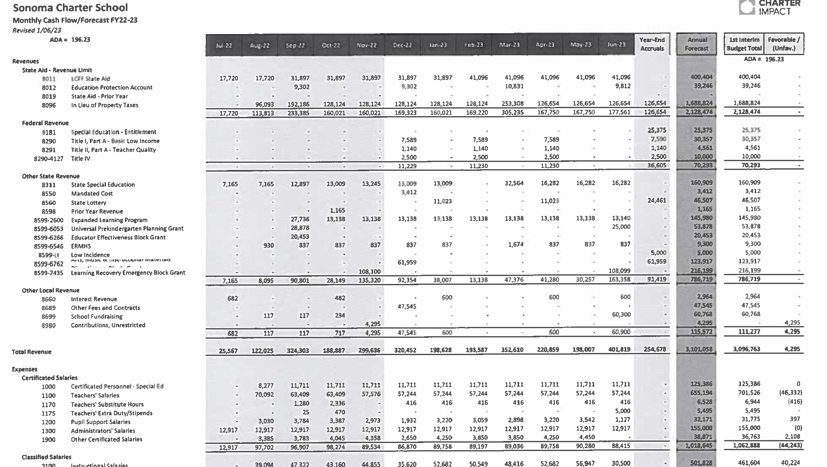
Let’s review our Current Budget!

Slide 12
Budget Reduction
The best tools you have are a good knowledge of your budget and good communication practices.
Share all information with the staff and community.
  Involve stakeholders in creating recommendations
  Consider community meetings or board workshop (!)
Give a specific goal, i.e. $350,000 in reductions, how will we do this?
The administration knows the budget best and will make recommendations about how to accomplish this after staff and community input re:priorities.
There is no best process. Match the culture and practices of your community and staff.
Be flexible
Reducing the budget is never fun, but can be really valuable in developing priorities and building community

Slide 13
What is the “skeleton” budget?
Built on your PRIORITIES and Budget assumptions:
  Enrollment: trends, expectations, actual ADA percent.
    Be conservative with ADA if predicting growth
    If in decline, may use prior year ADA
  Staffing - project ACCURATELY - no extra hires!
  Revenue limit
  All other sources of income – under-estimate (categoricals, interest…)
  All expenditures - overestimate and don’t forget long term commitments (i.e. salary and benefits) and encroachments (special education).
  Any changes??? Projects? Modernizing? Plan on overage.
  Future projections

Slide 14
MAINTAINING Staff and Trying to keep up with SVUSD Salaries
Since salaries are usually at least 80% of your budget, any change impacts the budget. SCS salaries are 85% of the total budget, they are closer to 95% of unrestricted revenue.
Only spend on-going money - never use one-time money for salary.
What are our comparable districts – is SVUSD is truly comparable?
CAREFULLY look at multiyear commitments or agreements - changes in circumstances can change the budget dramatically.

Slide 15

A word on staffing
Most of your budget goes here (>85%), so make sure to include:
Longevity costs
Fringe benefit costs, especially health benefits
Negotiated increases
Costs of contracted providers (especially in Special Ed)
If you have anything left, it’s magic or a miracle.
This Photo by Unknown Author is licensed under CC BY-NC

Slide 16
What will it take?
Catching up to Sonoma Valley:
  They gave certificated staff 18% over 2 years, this year and next.
  To bring our staff up to this year’s level in 23-24, will cost SCS about $70,000 +/-
  In 24-25, it would mean the same kind of increase. This will be very hard to sustain with declining enrollment, and a physical limit on how many students we can accommodate.
  Consider other comparable Districts, charters?

Slide 17
Building Understanding
…communication, communication, communication!
Provide opportunities to learn about the budget to the staff and community.
  Take the time to explain the budget to each group. (Your goal is to be able to do it on a cocktail napkin, and to make it “transparent.”)
  Communicate with stakeholders (staff and community) 2 or 3 times each year, especially during tough budget times. Explain what is going on and how they can give input and help! (Unaudited actuals, Second Interim, Budget)

Slide 18
Finally, some REALLY important Advice
Put people first - small districts are about relationships, and it is important that staff feels and IS valued and that the community feels confident in their school.
Everyone knows everyone in small schools, keep communication lines wide open and consistent.

